Slide 1
Classes & Interfaces

Slide 2
Classes & Interfaces
Classes
Inner Classes
Method-Local Inner Classes
Anonymous Inner Classes
Static Nested Classes
Interfaces
Enums

Slide 3
Classes
Class – is a prototype from which objects are created.
A class can contain any of the following variable types:
Local variables – variables defined inside methods, constructors, or blocks. The variable will be declared and initialized within the method and will be destroyed when the method has completed
Instance variables – variables within a class but outside any method. Instance variables can be accessed from inside any non-static method, constructor or blocks of that particular class
Class variables – variables declared in a class, outside any method, with the static keyword
A class can have any number of methods

Slide 4
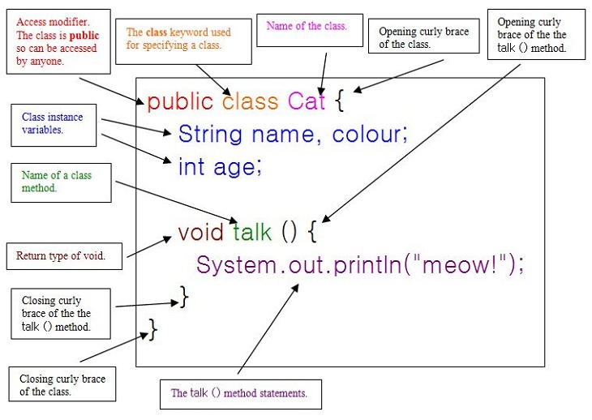
Class skeleton
Notes:
What is the constructor in this class?

Slide 5
Inner Classes
A “regular” inner class is declared inside the curly braces of another class
An inner class is a full-fledged member of the enclosing (outer) class, so it can be marked with an access modifier as well as the abstract or final modifiers.
An inner class instance shares a special relationship with an instance of the enclosing class. This relationship gives the inner class access to all of the outer class’ members, including those marked private.
To instantiate an inner class, you must have a reference to an instance of the outer class
Instantiate the inner class from code within the enclosing class
MyInner mi = new MyInner();
Instantiate the inner class from code outside the enclosing class
MyOuter mo = new MyOuter();
MyOuter.MyInner inner = mo.new MyInner();
Notes:
From code within the inner class, the keyword this holds a reference to the inner class instance. To reference the outer this precede the keyword this with the outer class name: MyOuter.this

Slide 6
Inner Class
class MyOuter {
private int x = 7;
// inner class definition
class MyInner {
public void seeOuter() {
System.out.println("Outer x is " + x);
}
} // close inner class definition
} // close outer class
public static void main(String[] args) {
MyOuter mo = new MyOuter(); // gotta get an instance!
MyOuter.MyInner inner = mo.new MyInner();
inner.seeOuter();
}
Notes:
Live codding …
To reference the outer this precede the keyword this with the outer class name: MyOuter.this

Slide 7
Method-Local Inner Classes
A method-local inner class is defined within a method of the enclosing class
A method-local inner class cannot use variables declared within the method (including parameters) unless those variables are marked final
The only modifiers we can apply to a method-local inner class are abstract and final.
To use the method-local inner class we must make an instance of it somewhere within the method but below the inner class definition (or the compiler won’t be able to find the inner class)

Slide 8
Inner Class
class MyOuter2 {
private String x = "Outer2";
void doStuff() {
class MyInner {
public void seeOuter() {
System.out.println("Outer x is " + x);
} // close inner class method
} // close inner class definition
MyInner mi = new MyInner();
mi.seeOuter();
} // close outer class method doStuff()
} // close outer class
Notes:
Live codding demonstrating final modifier.

Slide 9
Anonymous Inner Classes
Anonymous inner classes have no name and their type must be either a subclass of the named type or an implementation of the named interface
An anonymous inner class is always created as part of a statement
Because of polymorphism, the only methods you can call on an anonymous inner class reference are those defined in the reference variable class (or interface)
An argument-defined inner class is declared, defined and automatically instantiated as part of a method invocation

Slide 10
Anonymous Inner Classes
class Popcorn {
public void pop() {
System.out.println("popcorn");
}
}
class Food {
Popcorn p = new Popcorn() {
public void pop() {
System.out.println("anonymous popcorn");
}
};
}
Notes:
Live Codding:
public static void main(String[] args) { Food f = new Food(); f.p.pop(); Popcorn p = new Popcorn(); p.pop(); Popcorn anonymPop = new Popcorn(){ @Override public void pop() { System.out.println("Inline Inner"); } }; anonymPop.pop(); }

Slide 11
Anonymous Inner Classes
interface Cookable {
public void cook();
}
class Food {
Cookable c = new Cookable() {
public void cook() {
System.out.println("anonymous cookable implementer");
}
};
}
Notes:
Live codding.
public static void main(String[] args) { Food1 f1 = new Food1(); f1.c.cook(); new Cookable(){ @Override public void cook() { System.out.println("Inline Anonymous"); } }.cook(); }

Slide 12
Static Nested Classes
Static nested classes are inner classes marked with the static modifier
Because the nested class is static it does not share any special relationship with an instance of the outer class
Instantiating a static nested class requires using both the outer and nested class names, but no instance of outer class:
BigOuter.Nested n = new BigOuter.Nested();
A static nested class cannot access non-static members of the outer class, since it does not have an implicit reference to any outer instance (in other words, the nested class instance does not get an outer this reference)

Slide 13
Static Nested Class
class BigOuter {
static class Nest {
void go() { System.out.println("hi"); }
}
}
class Broom {
static class B2 {
void goB2() {
System.out.println("hi 2");
} }
public static void main(String[] args) {
BigOuter.Nest n = new BigOuter.Nest(); // both class names
n.go();
B2 b2 = new B2(); // access the enclosed class
b2.goB2();
}
}
Notes:
Live codding:
class Broom { public static int x = 3; static class B2 { void goB2() { System.out.println("hi 2"+x); } } public static void main(String[] args) { BigOuter.Nest n = new BigOuter.Nest(); // both class names n.go(); Broom.B2 b2 = new Broom.B2(); // access the enclosed class b2.goB2(); } }

Slide 14
Why do we need Interfaces
For aggregating different behaviors into a single class.
Notes:
interfaces are essential for single-inheritance languages like Java and C#
For example Flower class can implement Gift interface, and Plant interface.
Gift - > grant()
Plant - > getFamily()
If different objects all implement these two interfaces then they have the same methods, you can store all of those objects in a Vector, for example, and iterate through the Vector calling that methods of Gift or Plant at the same time on each one.

Slide 15
Interfaces
Interfaces are contracts for what a class can do, but they say nothing about the way in which the class must do it
Interfaces can be implemented by any class, from any inheritance tree
An interface is like a 100-percent abstract class and is implicitly abstract
An interface can have only abstract methods, no concrete methods allowed
Interface methods are by default public and abstract
Interfaces can have constants, which are always implicitly public, static and final (which are also optional)

Slide 16
Implementing Interfaces
A legal nonabstract implementing class has the following properties
It provides concrete implementations for the interface’s methods
It must follow all legal override rules for the methods it implements
It must not declare any new checked exceptions for an implementation method
It must not declare any checked exceptions that are broader than the exceptions declared in the interface method
It may declare runtime exceptions on any interface method
A class implementing an interface can itself be abstract
An abstract implementing class does not have to implement the interface methods (but the first concrete subclass must)
A class can extend only one class, but it can implement many interfaces
Interfaces can extend one or more other interfaces
Notes:
Live codding:
interface MyInterface { void method1(); } public class MyClass implements MyInterface { @Override public void method1() { System.out.println("MyClass Method1"); } } abstract class MyAbstractClass implements MyInterface { void method2() { System.out.printf("MyAbstractClass Method2"); } class MyConcretClass extends MyAbstractClass { @Override public void method1() { System.out.println("MyConcretClass method1"); } } }

Slide 17
Enum
An enum specifies a list of constant values assigned to a type
An enum is not a String or an int; an enum constant’s type is the enum type. For example, SUMMER and FALL are of the enum type Season
Enums can contain constructors, methods, variables and constant class bodies
Enum constructors can never be invoked directly in code. They are always called automatically when an enum is initialized
Notes:
An enum type is a special data type that enables for a variable to be a set of predefined constants.
Common examples include compass directions (values of NORTH, SOUTH, EAST, and WEST) and the days of the week.
Because they are constants, the names of an enum type's fields are in uppercase letters.

Slide 18
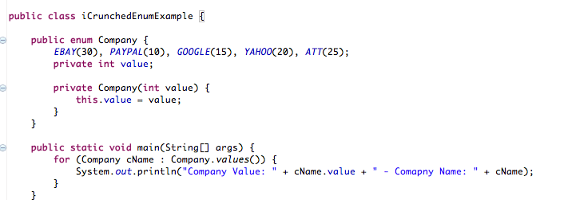
Enums

Slide 19


Valentin Bragaru
Senior Developer
Valentin.bragaru@endava.com
en_vbragaru

